Slide 1


Fundamentals of RM
RM System and Process
Leadership in RM
Incident Investigation
RM Tools & Challenges
RM in Industry
People & Org.
Application and Perspectives
On Becoming a
Leader in Risk Management
ENGG404 - Lecture
Chapter 5.1:
Introduction to Tools to Reduce Risk
for Risk Management

Slide 2
Learning Outcomes:
Recognize the tools for leadership in risk management, and explain the overall purpose of these tools.
Explain how to resolve risk concerns by applying a risk reduction hierarchy (order of effectiveness).
Interpret, critique, and create the following risk management tools:
Field Level Risk Assessment
Semi-Quantitative Risk Assessment
Job Observations and Planned Inspections (Audits)
Apply all of these tools as a rudimentary skill of leadership to observe, interact, commend or intervene / coach employees in the work-place.
Explain how to ask and the benefits of asking “open-ended questions”.
Chapter 5.1 Tools for Risk Management
2
Notes:
2

Slide 3
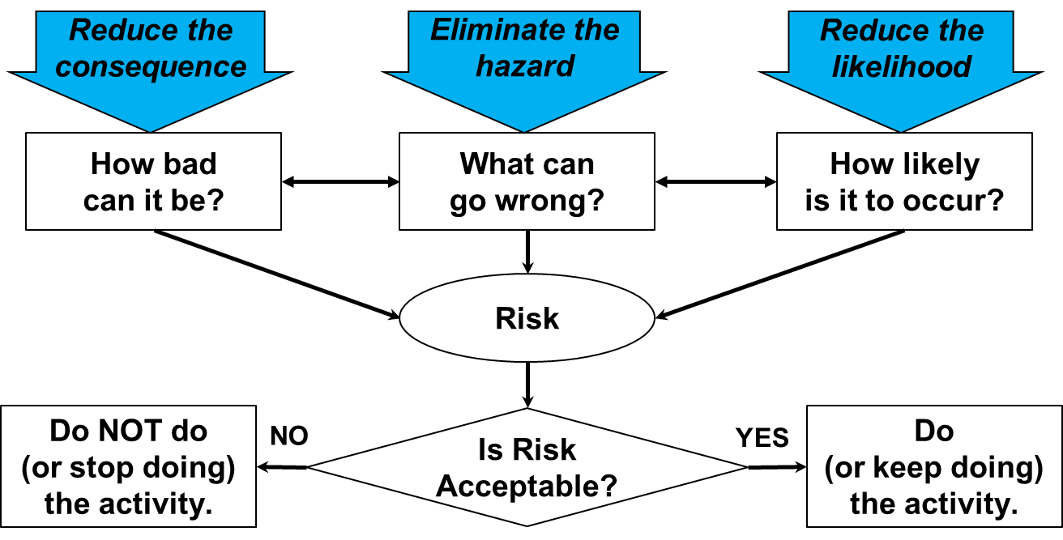
Recall “Something Bad Could Happen”:
Risk is a function of consequence and likelihood of an uncontrolled hazard.
Hazard: A potential source of serious harm to people, environment, assets or production.
Consequence: The harm imparted on people, environment, assets or production, when the hazard is uncontrolled
Chapter 5.1 Tools for Risk Management
3
Notes:
3

Slide 4
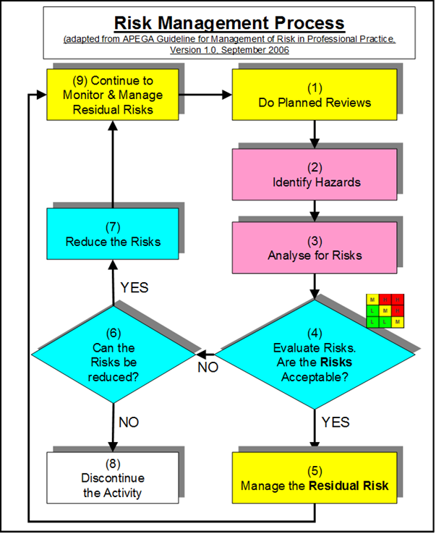

Risk Management Work Process
Recall the RM work process:
Risk determined before / without
control measures, but can also
be determined with control
measures.
Various tools can be used to
analyze and reduce risk to an
acceptable level i.e. reduce
consequence or likelihood, or
eliminate the hazard.
Chapter 5.1 Tools for Risk Management
4
Notes:
4

Slide 5
Risk Reduction Tools:
In this course:
FLRA
SQRA
Planned Inspections & Audits
What-If Analysis
FLRAs
SQRAs
JSAs
Checklists
Planned Inspections & Audits
What tools have you used in your work terms? MM-Poll
Chapter 5.1 Tools for Risk Management
5
Notes:
5
The 5 tools we use and will be discussing each
Cdn Centre for OHS

Slide 6

Risk Reduction Tools:
Basic approach to these and similar risk reduction tools is the same:
“What are you doing?” (Activity)
“What can go wrong?” (Hazards and Risks)
“What are you going to do about it?”
(Control Measures)
Detailed Approach:
Any risk assessment methodology answers these questions in order to identify control measure to reduce risk to an acceptable level:
What are you doing? (Activity)
What could go wrong? (Hazard)
How bad could it be? (Consequence)
How likely is it to happen? (Likelihood)
Is it acceptable? (Risk)
What can I do about it? (Controls – Admin or Eng’g)
How does the control change the L and C?
(Reduce, remain unchanged, or increase?)
Chapter 5.1 Tools for Risk Management
6
Notes:
6
The 5 tools we use and will be discussing each
Cdn Centre for OHS

Slide 7
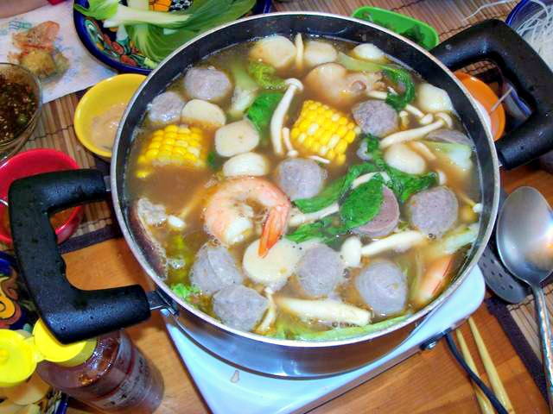
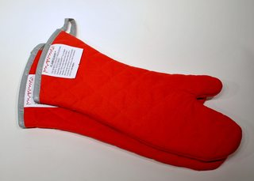
Example: Apply Risk Reduction to Making Soup
Common activity: “cooking noodle soup for lunch” and it needs to be done carefully to “prevent burning yourself”.
Responses to the questions:
Key activity: holding pot of boiling soup
Hazard or risk: hot handle, burn hand on hot handle
Control measure: use a pot holder or oven mitt.
Chapter 5.1 Tools for Risk Management
7
Notes:
7

Slide 8
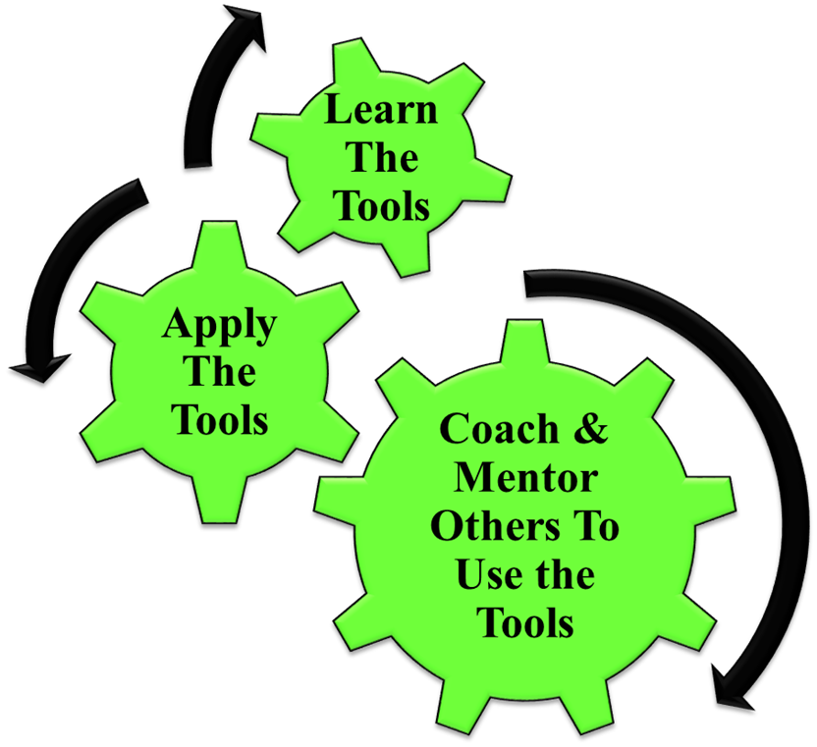
Leadership in Risk Management – Application & Coaching:
How Does This Apply To You as Engineers?
These powerful management tools can positively
influence safety culture in two ways:
Application:
  manage risks to acceptable
  levels and prevent incidents.
Coaching & Mentoring:
  Trains managers to be effective;
  Raises the visibility:
    “walk the talk”
    “lead by example”
  Engages workers and sets expectations for leader-worker interactions!
Q: How and Why?
Chapter 5.1 Tools for Risk Management
8
Notes:
8

Slide 9
Leadership in Risk Management – Application & Coaching:
How are these powerful management tools applied and why?
Apply this Key Leadership Skill:
Successful leaders must develop and practice
their ability to ask “open-ended questions”:
“Help me understand the work you are
doing and its hazards.”
“Can you explain to me how your work is
done, and how to improve it?”
“Can you tell me about the hazards and safeguards
that are associated with your work?”
Why?
Demonstrates management commitment and leadership (#1 MLCA)
Coach in a visible and effective manner (supportive, not adversarial, not confrontational).
Chapter 5.1 Tools for Risk Management
9
Notes:
9

Slide 10


Summary:
Any risk assessment methodology
answers these questions:
What are you doing? (Activity)
What could go wrong? (Hazard)
How bad could it be? (Consequence)
How likely is it to happen? (Likelihood)
Is it acceptable? (Risk)
What can I do about it? (Controls – Admin or Eng’g)
How does the control change the L and C?
(Reduce, remain unchanged, or increase?)
Many different risk reductions tools with
the same basic approach and same outcome.
A leader uses these tools to positively influence
safety culture by demonstrating commitment and
leadership.
Key Leadership Skill: Ability to ask “open-ended questions”.
Chapter 5.1 Tools for Risk Management
10
Notes:
10

Slide 11
Complete Slide Deck follows with details.
11
Notes:
11

Slide 12
Learning Outcomes:
Recognize the tools for leadership in risk management, and explain the overall purpose of these tools.
Explain how to resolve risk concerns by applying a risk reduction hierarchy (order of effectiveness).
Interpret, critique, and create the following risk management tools:
Field Level Risk Assessment
Semi-Quantitative Risk Assessment
Job Observations and Planned Inspections (Audits)
Apply all of these tools as a rudimentary skill of leadership to observe, interact, commend or intervene / coach employees in the work-place.
Explain how to ask and the benefits of asking “open-ended questions”.
Chapter 5.1 Tools for Risk Management
12
Notes:
12

Slide 13
Learning Outcomes:
Note: Your courseware may also include instruction on:
CCOHS Job Safety Analysis Model
Checklists for Executing Work
Multi-layered Approach to Hazard / Risk Assessment
Reporting and Correcting Sub-standard Conditions and
At-Risk Behaviours (Sub-standard Practices)
Job Observations and Planned Inspections
Apply all of these tools (the above and Field Level Risk Assessment,
Semi-Quantitative Risk Assessment, Job Observations and Planned Inspections (Audits)) as a rudimentary skill of leadership to observe, interact, commend or intervene / coach employees in the work-place.
Chapter 5.1 Tools for Risk Management
13
Notes:
13

Slide 14

Recall “Something Bad Could Happen”:
Recall these two definitions:
Hazard: A potential source of serious harm to people, environment, assets or production.
Consequence: The harm imparted on people, environment, assets or production, when the hazard is uncontrolled
Risk – “something bad could happen”:
    The possibility of loss exposures (PEAP) created by a hazard.
    The significance of risk is a function of the likelihood of an unwanted incident and the consequence or the impact on PEAP.
Several methodologies are widely
practiced. In practice, there are
countless variations of these tools,
and some go by different names.
Your gaining skills in these builds
your skills in most of those variations.
Chapter 5.1 Tools for Risk Management
14
Notes:
14

Slide 15
Risk Management Work Process
Recall the RM work process:
Risk determined before / without
control measures, but can also
be determined with control
measures.
Various tools can be used to
analyze and reduce risk to an
acceptable level i.e. reduce
consequence or likelihood, or
eliminate the hazard.
Chapter 5.1 Tools for Risk Management
15
Notes:
15

Slide 16
Risk Reduction Tools:
Common Risk Reduction Tools used in Industry for Assessing Risk, and Reducing & Controlling Risk to An Acceptable Level
FLRAs
SQRAs
JSAs
Checklists
Planned Inspections & Audits
What tools have you used in your work terms? MM-Poll
Chapter 5.1 Tools for Risk Management
16
Notes:
16
The 5 tools we use and will be discussing each
Cdn Centre for OHS

Slide 17
Risk Reduction Tools:
In this course:
FLRA
SQRA
Planned Inspections & Audits
What-If Analysis
FLRAs
SQRAs
JSAs
Checklists
Planned Inspections & Audits
Chapter 5.1 Tools for Risk Management
17
Notes:
17
The 5 tools we use and will be discussing each
Cdn Centre for OHS

Slide 18
Risk Reduction Tools:
Basic approach to these and similar risk reduction tools is the same:
“What are you doing?” (Activity)
“What can go wrong?” (Hazards and Risks)
“What are you going to do about it?” (Control Measures)
Detailed Approach:
Any risk assessment methodology answers these questions in order to identify control measure to reduce risk to an acceptable level:
What are you doing? (Activity)
What could go wrong? (Hazard)
How bad could it be? (Consequence)
How likely is it to happen? (Likelihood)
Is it acceptable? (Risk)
What can I do about it? (Controls – Admin or Eng’g)
How does the control change the L and C?
(Reduce, remain unchanged, or increase?)
Chapter 5.1 Tools for Risk Management
18
Notes:
18
The 5 tools we use and will be discussing each
Cdn Centre for OHS

Slide 19
Example: Apply Risk Reduction to Making Soup
Common activity: “cooking noodle soup for lunch” and it needs to be done carefully to “prevent burning yourself”.
Responses to the questions:
Key activity: holding pot of boiling soup
Hazard or risk: hot handle, burn hand on hot handle
Control measure: use a pot holder or oven mitt.
Chapter 5.1 Tools for Risk Management
19
Notes:
19

Slide 20
Leadership in Risk Management:
How Does This Apply To You as Engineers?
Chapter 5.1 Tools for Risk Management
20
Notes:
20

Slide 21
Leadership in Risk Management – Application & Coaching:
How Does This Apply To You as Engineers?
These powerful management tools can positively
influence safety culture in two ways:
Application:
  manage risks to acceptable
  levels and prevent incidents.
Coaching & Mentoring:
  Trains managers to be effective;
  Raises the visibility:
    “walk the talk”
    “lead by example”
  Engages workers, sets expectations for leader-worker interactions, and supports interactions with employees about the hazards/risks they face on-the-job and how they are going to manage those hazards/risks!
Q: How and Why?
Chapter 5.1 Tools for Risk Management
21
Notes:
21

Slide 22
Leadership in Risk Management – Application & Coaching:
How are these powerful management tools applied and why?
Apply this Key Leadership Skill:
Successful leaders must develop and practice
their ability to ask “open-ended questions”:
“Help me understand the work you are
doing and its hazards.”
“Can you explain to me how your work is
done, and how to improve it?”
“Can you tell me about the hazards and safeguards
that are associated with your work?”
Why?
The leader demonstrates management commitment and leadership (#1 MLCA) by applying and coaching in a visible and effective manner (supportive, not adversarial, not confrontational).
Chapter 5.1 Tools for Risk Management
22
Notes:
22

Slide 23
Summary:
Any risk assessment methodology
answers these questions:
What are you doing? (Activity)
What could go wrong? (Hazard)
How bad could it be? (Consequence)
How likely is it to happen? (Likelihood)
Is it acceptable? (Risk)
What can I do about it? (Controls – Admin or Eng’g)
How does the control change the L and C?
(Reduce, remain unchanged, or increase?)
Many different risk reductions tools with
the same basic approach and same outcome.
A leader uses these tools to positively influence
safety culture by demonstrating commitment and
leadership.
Key Leadership Skill: Ability to ask “open-ended questions”.
Chapter 5.1 Tools for Risk Management
23
Notes:
23

